Slide 1
7. Supervisor Operations
ADVANCED
OPERATIONS
TRAINING
© Copyright Scality 2022
RING 8.5

Slide 2
Supervisor Operations
At the end of this module, you will be able to …
… understand the Supervisor architecture
… operate its services
… and also manage its failure.
Notes:
Last update: 20180410

Slide 3
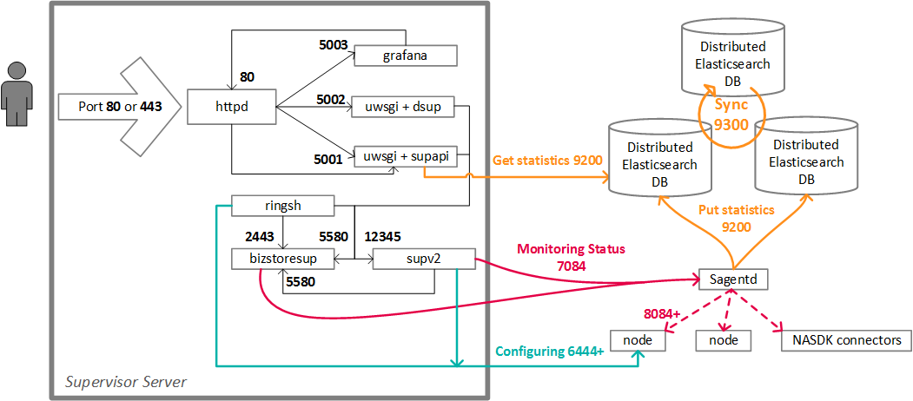
Supervisor Overview

Slide 4
Supervisor Operations
Stopping Supervisor services (CentOS|RedHat 7):
Starting Supervisor services (CentOS|RedHat 7):
Logs are in /var/log/scality-supervisor/.
For more operations and commands for other OS, check out “RING Maintenance” in the Scality RING Operations guide found on 🔗https://documentation.scality.com.
systemctl stop scality-supervisor
systemctl stop uwsgi
systemctl stop grafana-server
systemctl stop httpd
systemctl start scality-supervisor
systemctl start uwsgi
systemctl start grafana-server
systemctl start httpd

Slide 5
Supervisor Protection
There is no High-Availability for the Supervisor included in Scality.
Although the Supervisor is not a SPOF, it is still important for management tasks.
The customer must set up a failover mechanism for the Supervisor.
Ask your Scality Customer Solutions Engineer for recommendations adapted to your environment (e.g. virtual vs physical).

Slide 6
Supervisor Server Failure
Impact
Without a failover mechanism:
No impact on the storage service: the Supervisor is not involved in processing application requests.
Loss of RING management and monitoring capabilities; the admin is blind.
No Join: if a server goes offline and returns, its nodes will not be able to re-join the RING.
No Balance: if there are misplaced objects, they stop being moved back.
Actions
If failover mechanism (not included with Scality software): refer to the appropriate documentation.
Try restarting the services (see Supervisor Operations slide), then the server:
If it comes back intact, nothing to do.
If the Supervisor requires restoration ➡ create a P2 ticket at 🔗https://support.scality.com.

Slide 7

QUESTIONS ?

